Slide 1
Chemistry 2
Lecture 2
Particle in a box approximation

Slide 2
Learning outcomes from Lecture 1
Use the principle that the mixing between orbitals depends on the energy difference, and the resonance integral, β.
Apply the separation of σ and π bonding to describe electronic structure in simple organic molecules.
Rationalize differences in orbital energy levels of diatomic molecules in terms of s-p mixing.
Assumed knowledge for today
Be able to predict the geometry of a hydrocarbon from its structure and account for each valence electron. Predict the hybridization of atomic orbitals on carbon atoms.

Slide 3
The de Broglie Approach
The wavelength of the wave associated with a particle is related to its momentum:
p = mv = h / λ
For a particle with only kinetic energy: E = ½ mv² = p² / 2m = h² / 2mλ²
For a free particle, λ, can have any value:
E for a free particle is not quantized

Slide 4
“The particle in a box”
The box is a 1d well, with sides of infinite potential, where the particle cannot be…
E
0
x
0
L
see worksheet

Slide 5
“The particle in a box”
Energy is quantized:
E_{n} = h²n² / 8mL²
Lowest energy (zero point) is not zero: E_{n=1} = h² / 8mL²
Allowed levels are separated by:
ΔE = E_{n+1} - E_{n} = h²(2n+1) / 8mL²

Slide 6
The Schrödinger Equation Approach
The total energy is extracted by the Hamiltonian operator.
These are the “observable” energy levels of a quantum particle
Energy eigenfunction
Hamiltonian operator
Energy eigenvalue

Slide 7
The Schrödinger equation
The Hamiltonian has parts corresponding to Kinetic Energy and Potential Energy. In one dimension, x:
ħ = h / 2π (“h bar”)
Potential Energy
Hamiltonian operator
Kinetic Energy

Slide 8
“The particle in a box”
The box is a 1d well, with sides of infinite potential, where the electron cannot be…
E
0
x
0
L

Slide 9
“The particle in a box”
The particle cannot exist outside the box… Ψ = 0 {x<0;x>L (boundary conditions)
E
?
?
0
x
0
L

Slide 10
“The particle in a box”
Let’s try some test solutions
Ψ = sin(πx/L) {x>0;x<L
E
0
x
0
L

Slide 11
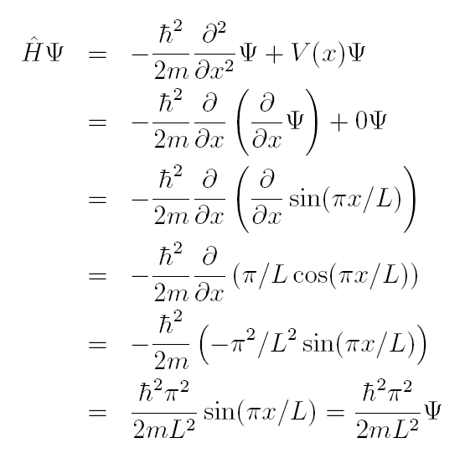
“The particle in a box”
Zero potential inside box
=εΨ !!!

Slide 12
“The particle in a box”
Other solutions?
Ψ = sin(2πx/L) {x>0;x<L
V
0
x
0
L

Slide 13
“The particle in a box”
Other solutions?
Ψ = sin(3πx/L) {x>0;x<L
V
0
x
0
L

Slide 14
“The particle in a box”
Other solutions?
Ψ = sin(4πx/L) {x>0;x<L
V
0
x
0
L

Slide 15
“The particle in a box”
Other solutions?
Ψ = sin(nπx/L) {x>0;x<L
ε_{n} = ℏ²n²π²/2mL²
V
?
0
x
0
L

Slide 16
“The particle in a box”
Ψ = sin(nπx/L) {x>0;x<L;n>0
ε_{n} = ℏ²n²π²/2mL²
Philosophical question: why is n = 0 not an appropriate solution?
Hint: what’s the probability of observing the particle?

Slide 17
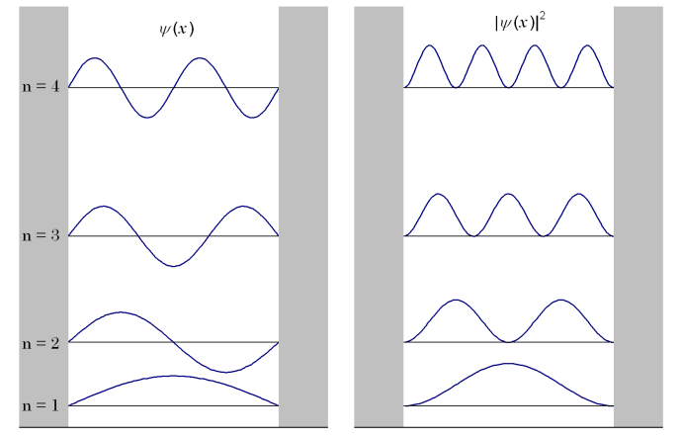
“The particle in a box”
Ψ = sin(nπx/L) {x>0;x<L;n>0 ε_{n} = ℏ²n²π²/2mL²
ε_{n}
0

Slide 18
π orbitals of cis-butadiene
three nodes
two nodes
The four p orbitals all
have the same energy
… interact and mix
one node
no node
(ignore plane)

Slide 19
π orbitals of hexatriene
The six p orbitals all
have the same energy
… interact and mix

Slide 20
Something to think about
Particle on a ring
Must fit even wavelengths into whole cycle

Slide 21
Next lecture
Particle-on-a-ring model
Week 10 tutorials
Schrödinger equation and molecular orbitals for diatomic molecules

Slide 22
Learning outcomes
Be able to explain why confining a particle to a box leads to quantization of its energy levels
Be able to explain why the lowest energy of the particle in a box is not zero
Be able to apply the particle in a box approximation as a model for the electronic structure of a conjugated molecule (given equation for E_{n}).

Slide 23
Practice Questions
The energy levels of the particle in a box are given by ε_{n} = ℏ²n²p²/2mL^{2.}
Why does the lowest energy correspond to n = 1 rather than n = 0?
What is the separation between two adjacent levels? (Hint: Δε = ε_{n+1} - ε_{n})
The π chain in a hexatriene derivative has L = 973 pm and has 6 π electrons. What is energy of the HOMO – LUMO gap? (Hint: remember that 2 electrons are allowed in each level.)
What does the particle in a box model predicts happens to the HOMO – LUMO gap of polyenes as the chain length increases?

